Slide 1
BANK FRAUD DETECTION
NAME:
1.THOWBIYA SALMA 3.SALMA S
2.FAHEEM HM 4.ABDUL SAHIL
DATE: 24–03-2024

Slide 2
INTRODUCTION
Bank fraud is a pressing issue in finance, exacerbated by digital transactions. Institutions combat this with advanced technologies like machine learning.
This report covers key aspects of fraud detection, including data exploration, model building, evaluation, and offers actionable recommendations.
Leveraging insights from academic literature and real-world applications, it aims to enhance security and mitigate risks effectively.
Fraudsters continually devise sophisticated schemes to exploit vulnerabilities in systems and processes, necessitating the adoption of advanced technologies like machine learning algorithms by financial institutions for fraud detection and prevention.

Slide 3
Challenges in Bank Fraud Detection
Sophisticated Fraud Tactics: Fraudsters continuously evolve their methods, making it challenging for traditional detection systems to keep up.
Volume and Velocity of Transactions: The sheer number and speed of transactions in digital banking make it difficult to identify fraudulent activity in real-time.
Diverse Fraud Types: Fraudulent activities range from account takeover to phishing attacks, requiring adaptable detection systems capable of recognizing various schemes.
Imbalanced Data and False Positives: The imbalance between fraudulent and legitimate transactions can lead to inaccurate models, resulting in false positives and unnecessary disruption for customers.

Slide 4
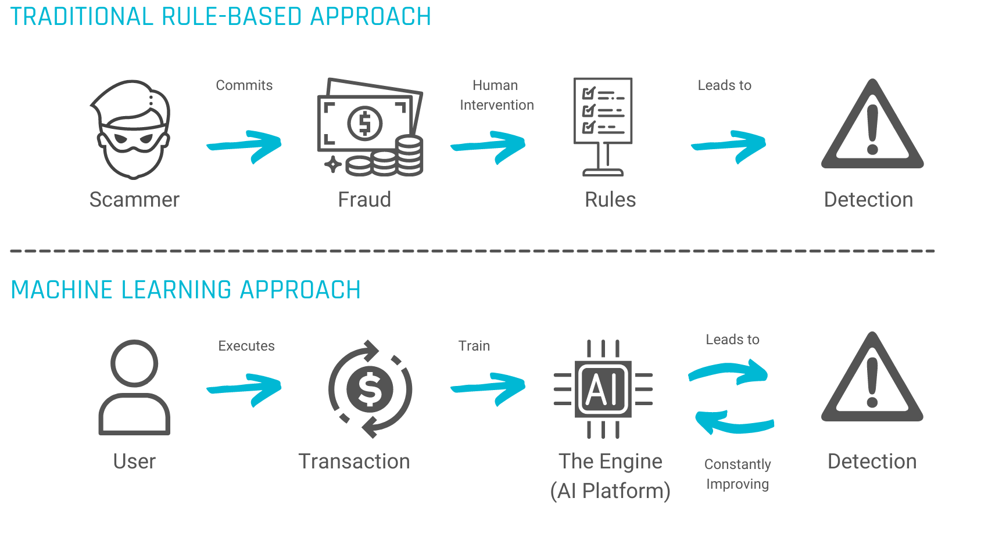
Role of Machine Learning (ML) in Fraud Detection
Fraud Detection Using Machine Learning allows you to run automated transaction processing on an example dataset or your own dataset. The included ML model detects potentially fraudulent activity and flags that activity for review.

Slide 5
PRE-PROCESSING
Data preprocessing is an important step in preparing the data for the loan amount prediction model. The following steps were taken to preprocess the data:
STEPS | DESCRIPTION
1. Data Cleaning | Removing or correcting any missing, incorrect, or irrelevant data.
2. Feature Scaling | Scaling the features to a standard range to prevent any feature from dominating the model.
3. Feature Encoding | Converting categorical variables into numerical representations for the model to understand
4. Feature Selection | Selecting the most relevant features that have the most impact on the loan amount prediction.
5. Data Splitting | Splitting the data into training and testing sets to evaluate the model's performance.

Slide 6

MODEL SELECTION
RANDOM FOREST
Random forest is a commonly-used machine learning algorithm, trademarked by Leo Breiman and Adele Cutler, that combines the output of multiple decision trees to reach a single result.
Its ease of use and flexibility have fueled its adoption, as it handles both classification and regression problems.

Slide 7
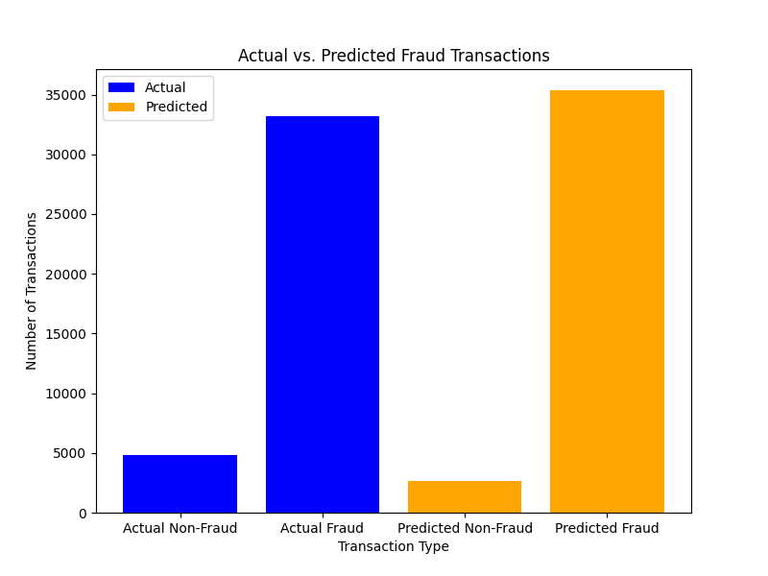
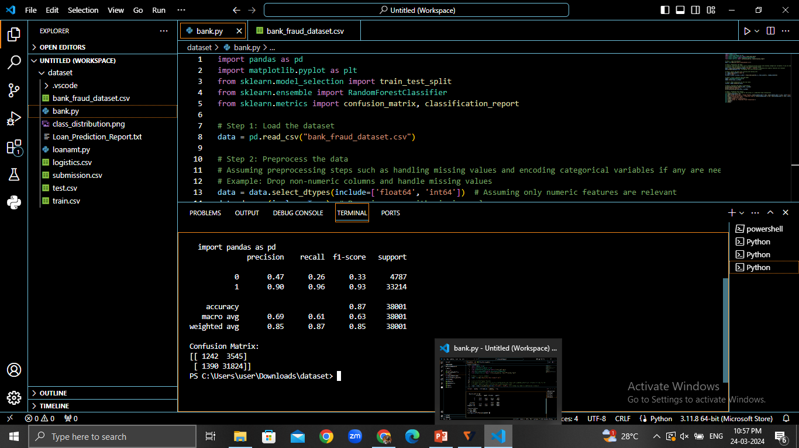
RESULT

Slide 8
FUTURE OUTLOOK
The future of bank fraud detection holds promise through the integration of advanced technologies like artificial intelligence (AI) and blockchain.
These technologies offer enhanced capabilities for detecting and preventing fraudulent activities, providing more robust security measures for financial institutions.
Furthermore, continued research and development efforts are necessary for staying ahead of fraudsters, adapting to emerging threats, and continually improving fraud detection systems to ensure the integrity of financial transactions.
Together, these strategies will shape the future landscape of bank fraud detection, fortifying the financial sector against fraudulent activities.

Slide 9
CONCLUSION
In conclusion, we've discussed the critical aspects of bank fraud detection, highlighting the importance of staying ahead of evolving fraud tactics and the necessity for proactive measures
.
Emphasizing the significance of detecting and preventing fraud before it occurs, we underscore the urgency of implementing recommended strategies.
With an accuracy rating of 0.87, it's clear that these measures are essential for safeguarding financial systems and maintaining trust with stakeholders.

